Slide 2
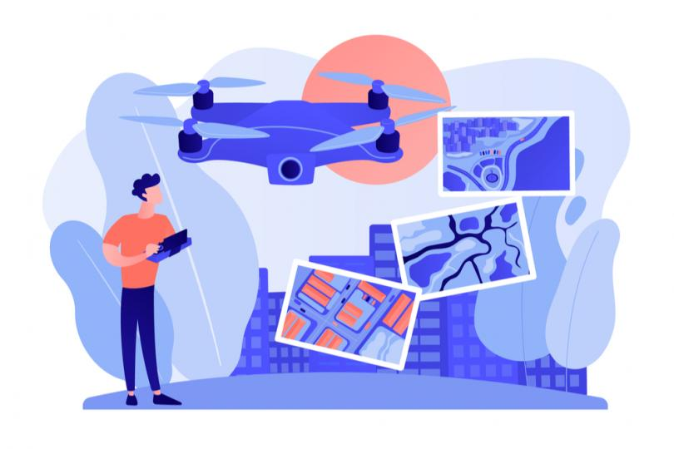
Drone Structure and
3D modelling

Slide 3
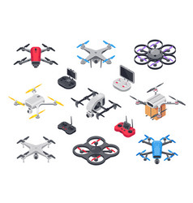
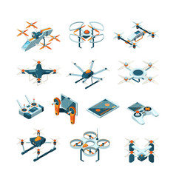
The term “drone” usually refers to any unpiloted aircraft. Sometimes referred to as “Unmanned Aerial Vehicles" (UAVs), these crafts can carry out an impressive range of tasks, ranging from military operations to package delivery.

Slide 4

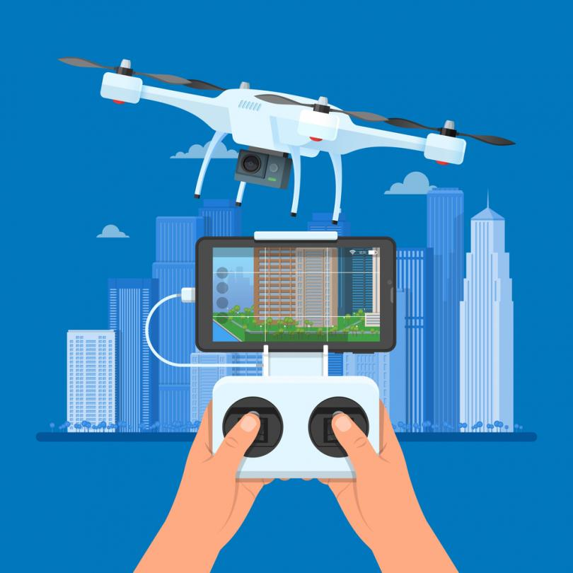
Originally developed for the military and aerospace industries, drones have found their way into the mainstream because of the enhanced levels of safety and efficiency they bring. A drone’s autonomy level can range from remotely piloted (a human controls its movements) to advanced autonomy, which means that it relies on a system of sensors and LIDAR (Light Detection and Ranging) detectors to calculate its movement.

Slide 5
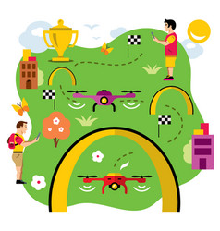

Different drones are capable of traveling varying heights and distances.
Very close-range drones usually have the ability to travel up to three miles and are mostly used by hobbyists.
Close-range UAVs have a range of around 30 miles.
Short-range drones travel up to 90 miles and are used primarily for espionage and intelligence gathering.
Mid-range UAVs have a 400-mile distance range and could be used for intelligence gathering, scientific studies and meteorological research.
The longest-range drones are called “endurance” UAVs and have the ability to go beyond the 400-mile range and up to 3,000 feet in the air.

Slide 6
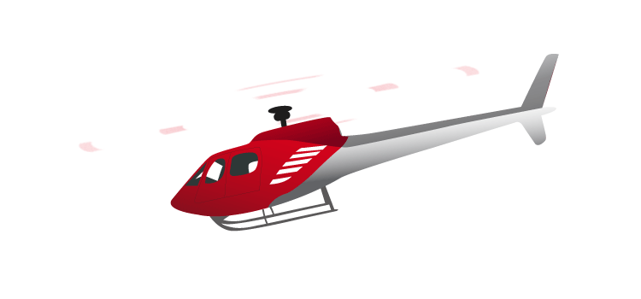
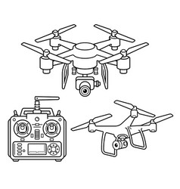
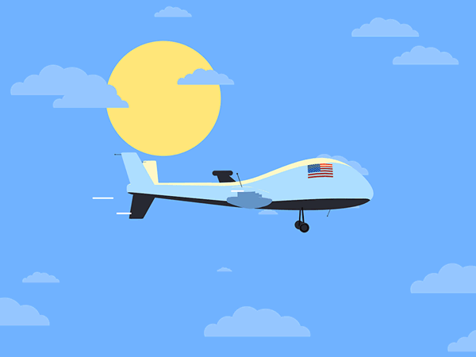
Single rotor helicopters look exactly like tiny helicopters and can be gas or electric powered. The single blade and ability to run on gas helps its stability and improves its flight range.
Multi-rotor drones are usually some of the smallest and lightest drones on the market. They have limited distance, speed and height, but make the perfect flying vehicle for enthusiasts and aerial photographers.
Fixed wing drones look like normal airplanes, where the wings provide the lift instead of rotors- making them very efficient. These drones usually use fuel instead of electricity, allowing them to glide in the air for more than 16 hours. Since these drones are usually much larger, and because of their design, they need to take off and land on runways just as airplanes do.

Slide 7
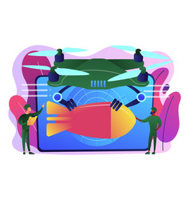
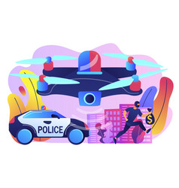

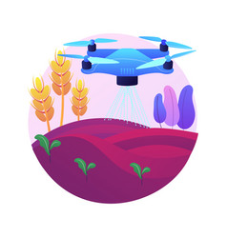
Uses

Slide 8
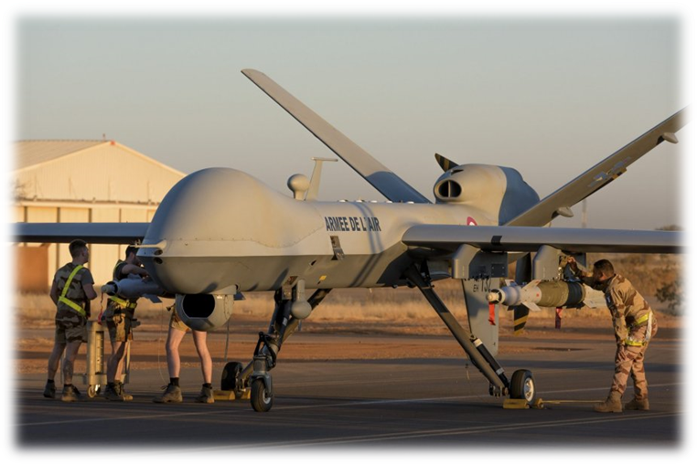
Military
Probably the oldest, most well-known and controversial use of drones is in the military. The most prominent military drone in use today is the MQ-9 Reaper.

Slide 9
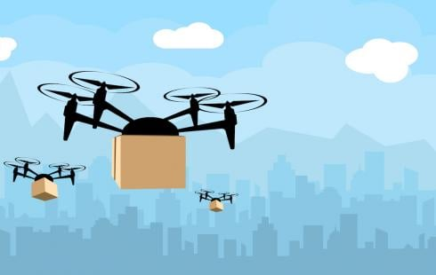
Delivery
Delivery drones are usually autonomous UAVs that are used to transport food, packages or goods to your front doorstep. These drones can carry an impressive 55 pounds of goods to house door.

Slide 10
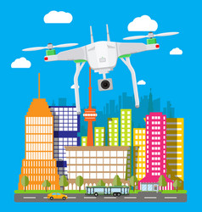
Emergency rescue
Sometimes it’s just not safe enough to send humans into a rescue situation due to the scope or severity of the disaster. That’s where drones come in.
Medicine
Right now, unmanned aerial vehicles can be used to deliver emergency medical supplies or to deliver donated organs to transplant patients.

Slide 11
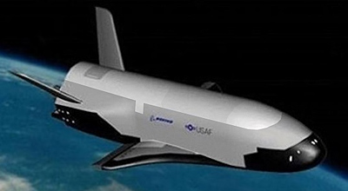
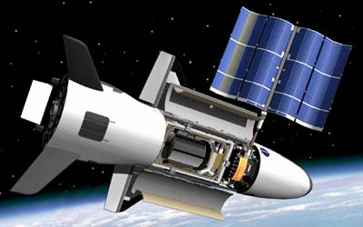
Outer Space
NASA and the U.S. Air Force have been secretly testing out unmanned aircraft geared towards space travel. The X-37B UAV is the Air Force’s ultra-secretive drone that looks like a miniature space shuttle. It has been quietly circling the Earth for the last two years, setting a record for longest flight from an unmanned aircraft (more than 719 days).

Slide 12
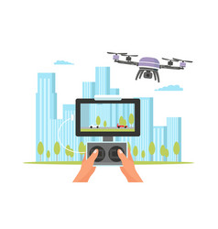
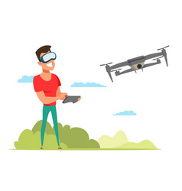
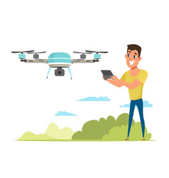
Quadcopter
“Quadcopter” is a more specific term used to refer to a drone that is controlled by four rotors.

Slide 13
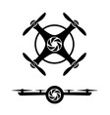
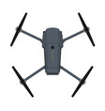
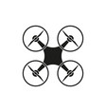
The reason why quadcopters became so popular is their simple mehanical design, their safety (due to smaler rotors) and a lot easier software to manipulate with.
Thanks to its four rotors, quadcopter has same stability in flight as other types of drones, but has a simplier mechanism.

Slide 14
When we look at aerodynamics, the symmetrical shape of the quadcopter is its leading advantage over the competition, because it is very easy to balance the drone itself in flight, with as little power and knowledge as possible.
The arrangement of the rotor on the square-shaped quadcopter makes the quadcopter extremely stable.
As a consequence of good aerodynamics, the quadcopter has an increased range for the same amount of fuel, ie battery, compared to competitors.
Also, the quadcopter is easy to balance around its axes, which gives it great stability when shooting, photographing and observing.

Slide 15
Further development of drones leads to an increase in the capability of quadcopters by making progress in the Communication between the transmitter and the drone, as well as in the maneuverability of the drone itself.
If these characteristics in the development of the drone are properly paired, then the quadcopters become capable of performing various more complex missions and tasks.

Slide 16
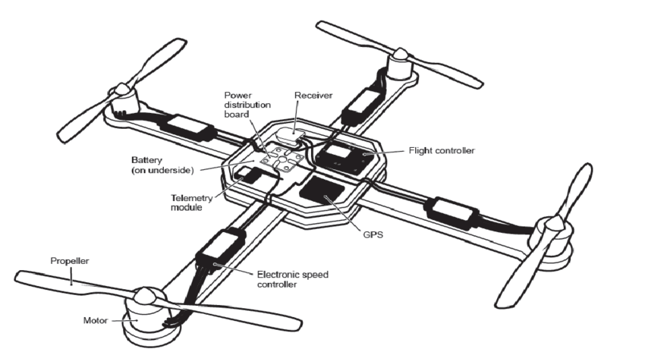
Structure

Slide 17
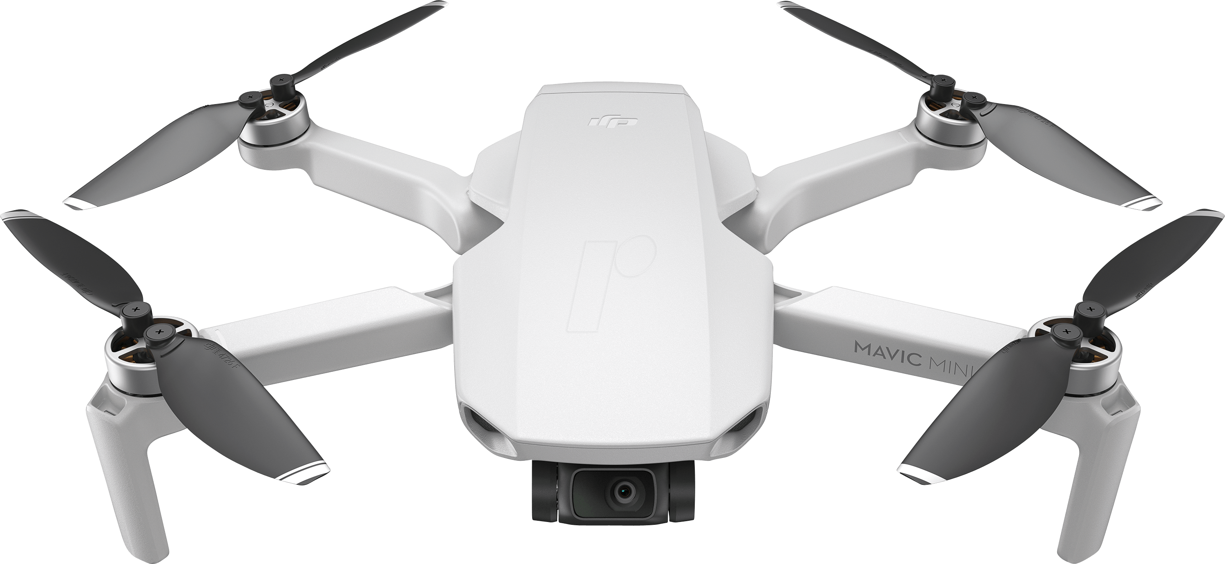
Quadcopter is an advance highly maneuverable aircraft which has a simple design and structure. It has high load carrying capacity and other characteristics. Quadcopter is one of the UAV (Unmanned aerial vehicle) which is used to lift, carry, observe, rescue and collect data from one place to another in lesser time and without taking much space and cost. It can be used for surveillance purpose and military operations.

Slide 18
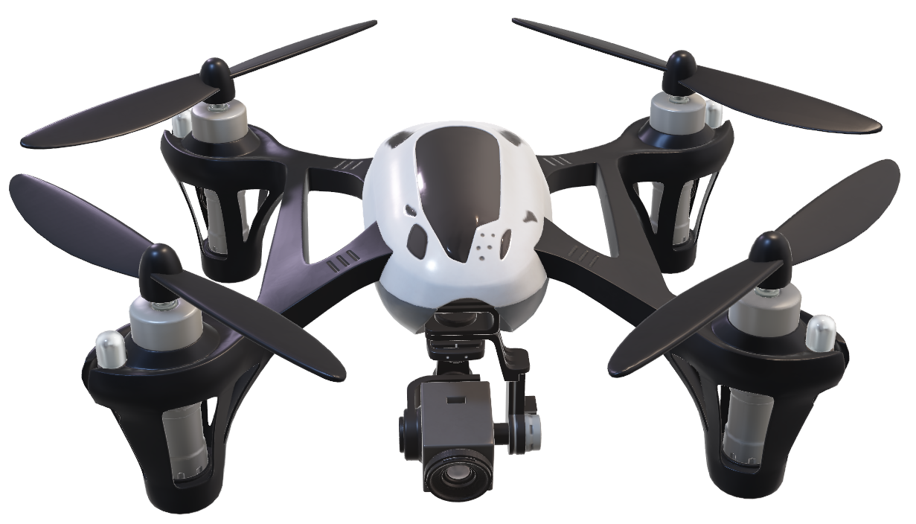
The static and dynamic characteristics of the structure of quadcopter have been analyzed by determining and analyzing the dynamics of the quadcopter. This paper describes the overall design of quadcopter frame model, then analyzing the frame with commercial Finite element code ANSYS 18.0 (Academic research). Selecting the necessary material and structure that meets the strength and stiffness of requirement of the system

Slide 19
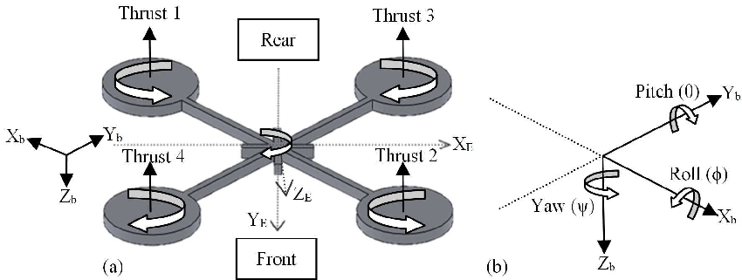
Quadcopters generally have two rotors spinning clockwise (CW) and two counterclockwise (CCW). Flight control is provided by independent variation of the speed and hence lift and torque of each rotor. Pitch and roll are controlled by varying the net centre of thrust, with yaw controlled by varying the net torque.

Slide 20
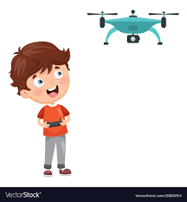
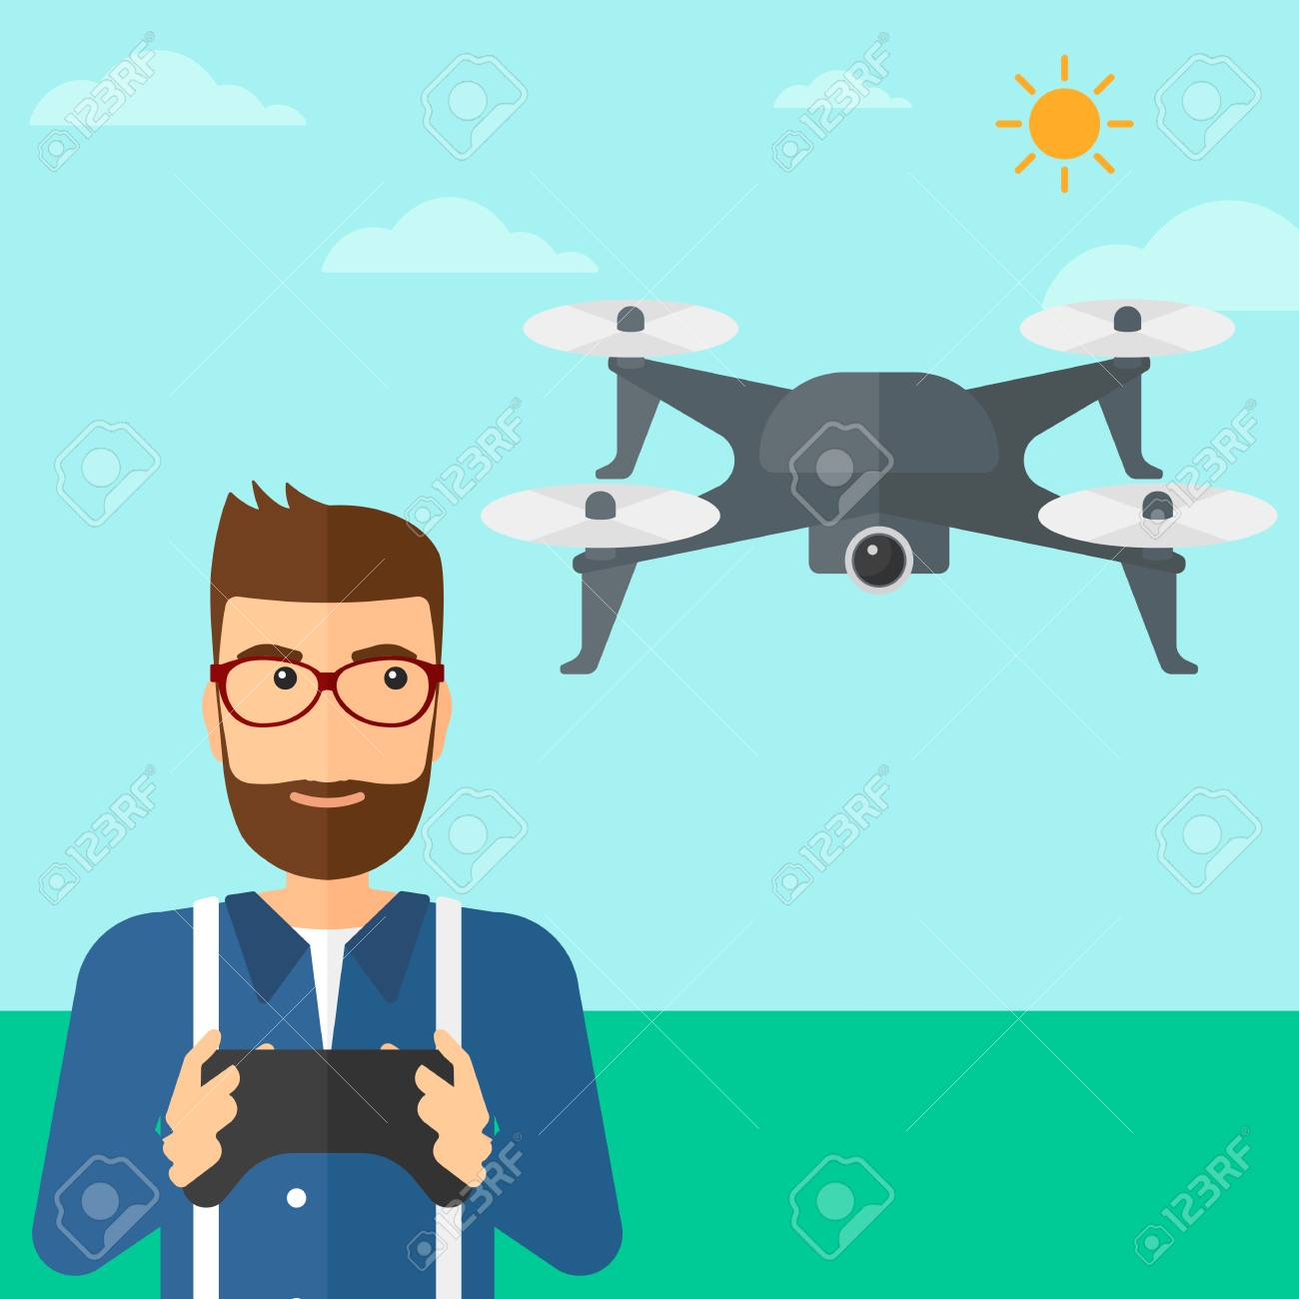
Drone aerodynamics are the most simple comparing with other flying machines (planes, drones, etc.).
Drones have multiple propellers which are making drone fly, and different rotations per minute of autonomous propellers make drones maneuverable.
Most drones are quadcopters. They have four propellers which are mounted in separation of 90 degrees from each other measuring from vertical axis.

Slide 21
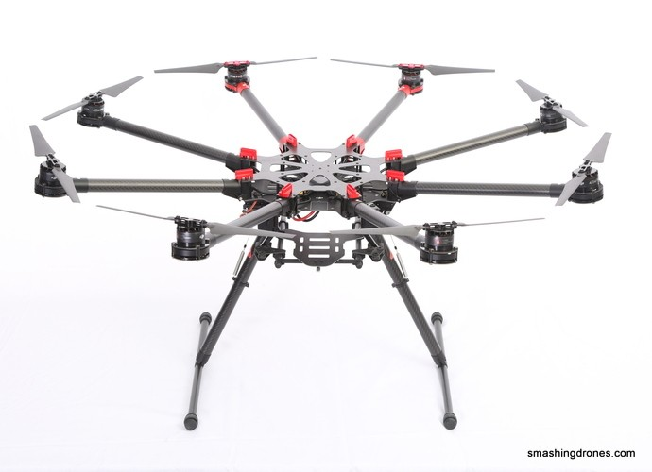
Number of propellers can vary, but generalized said drones can have from four to eight propellers, depending on use and size.

Slide 22
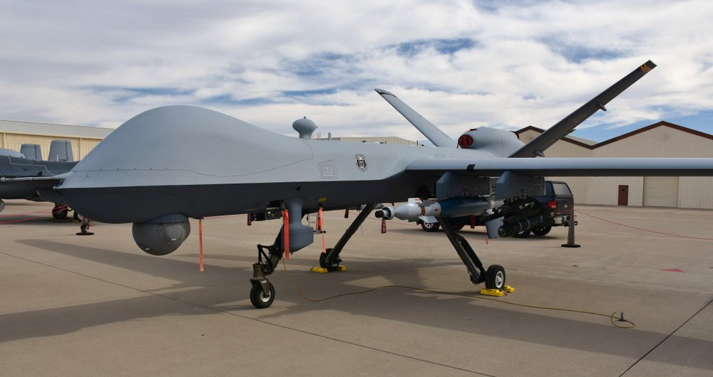
Drones use can be vast. Drones can be used in military, photographing, delivery and research.
Military drones are eliminating need for pilots for extreme complex flights, such as bombing, flying in compromised airspace etc.
Military drones usually have piston engines with propellers mounted at the rear. They are controlled by computer, or by a person sitting in naval base/other tactical position.
Endurance of these drones are enormous. They can last up to nine hours in the air.
Drones for commercial use are much smaller. The biggest commercial drones are used in agriculture and theirs top diameter is 1.5 meters.

Slide 23
Drone design
As part of our presentation, we will demonstrate two CATIA drone projects. The first project refers to a simpler configuration of the drone fuselage, and the second project is a more complex 3D model of the drone fuselage. Both of these projects are intended to demonstrate the simplicity of making the structure itself with the help of this CAD tool.
CATIA is the World's Leading Solution for Product Design and Experience. It is used by leading organizations in multiple industries to develop the products we see and use in our everyday lives. CATIA (an acronym of computer-aided three-dimensional interactive application) is a multi-platform software suite for computer-aided design (CAD), computer-aided manufacturing (CAM), computer-aided engineering (CAE), PLM and 3D, developed by the French company Dassault Systèmes.

Slide 24
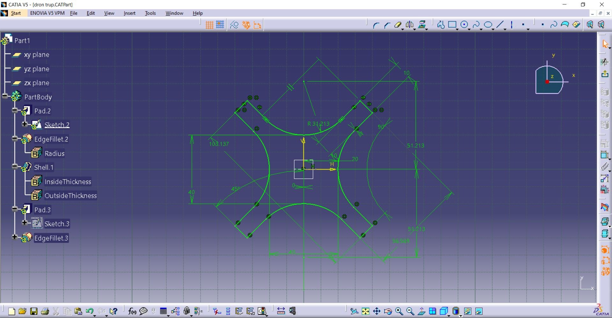

Slide 25
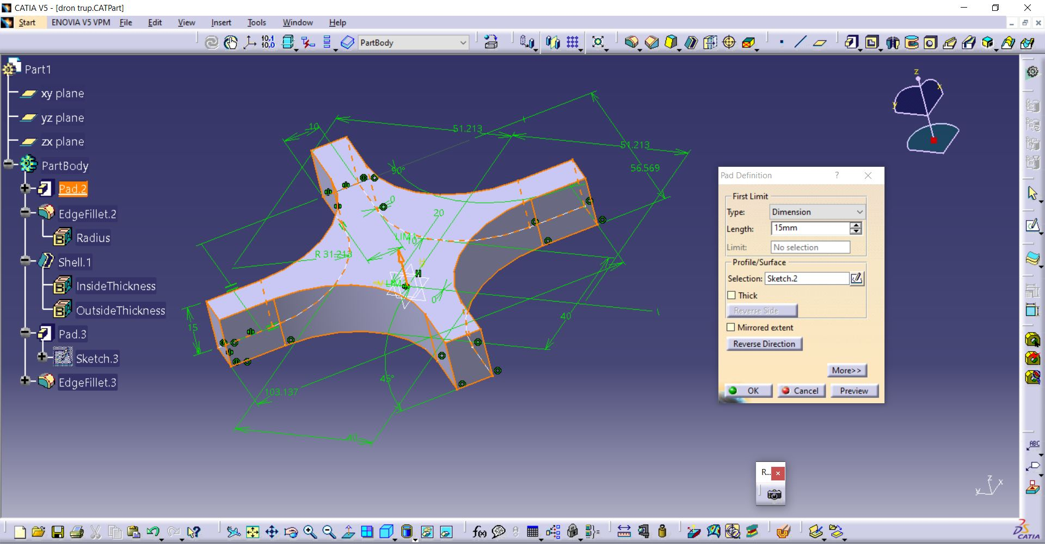

Slide 26
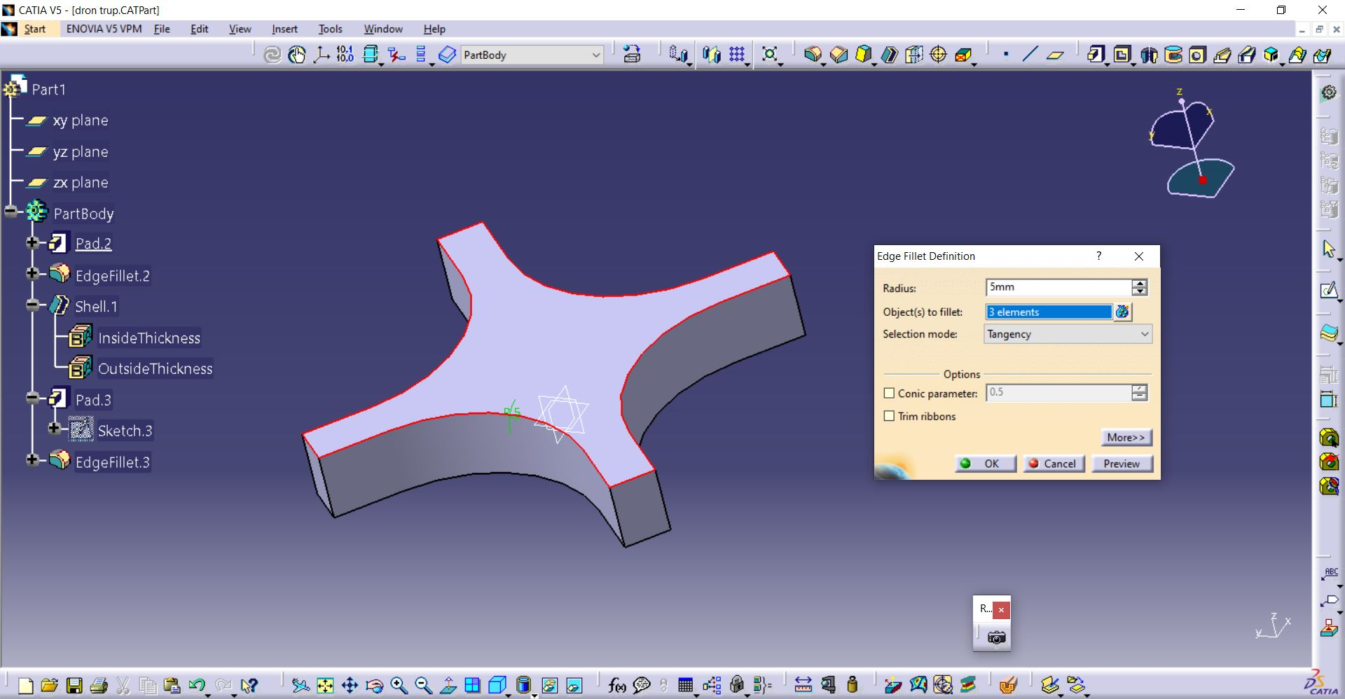

Slide 27
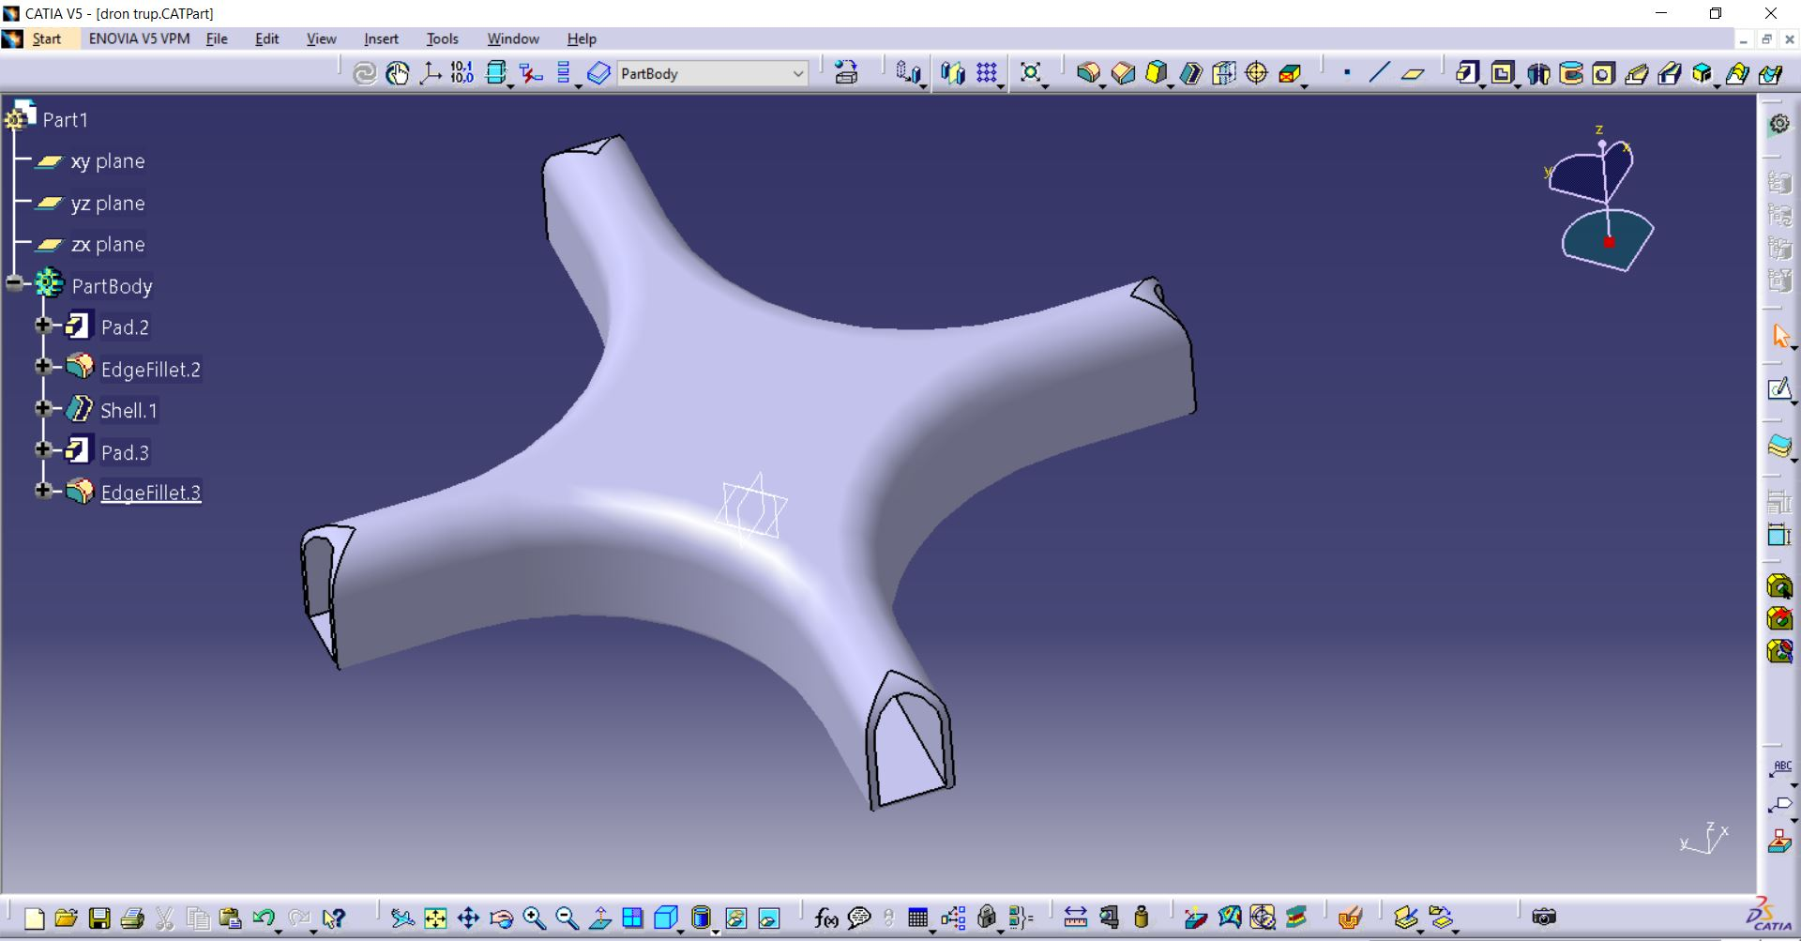

Slide 28
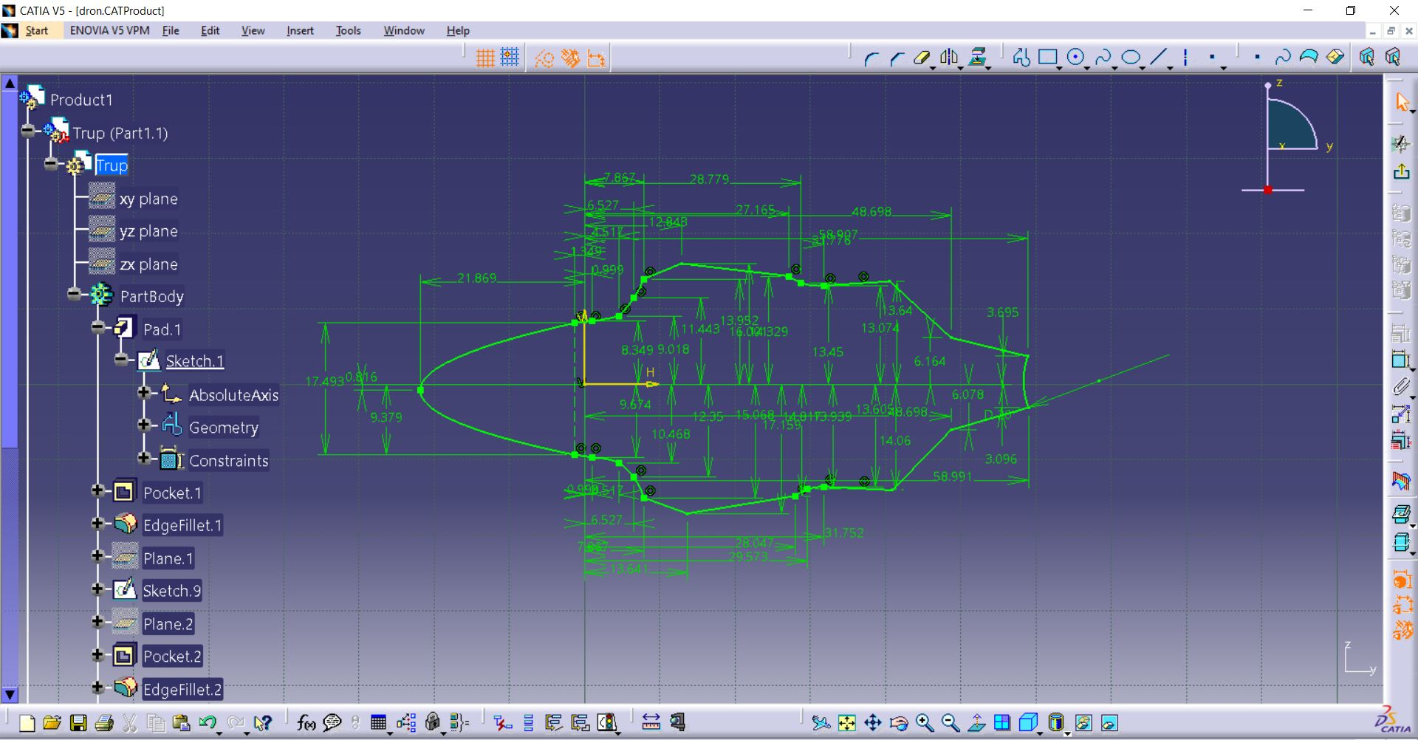

Slide 29
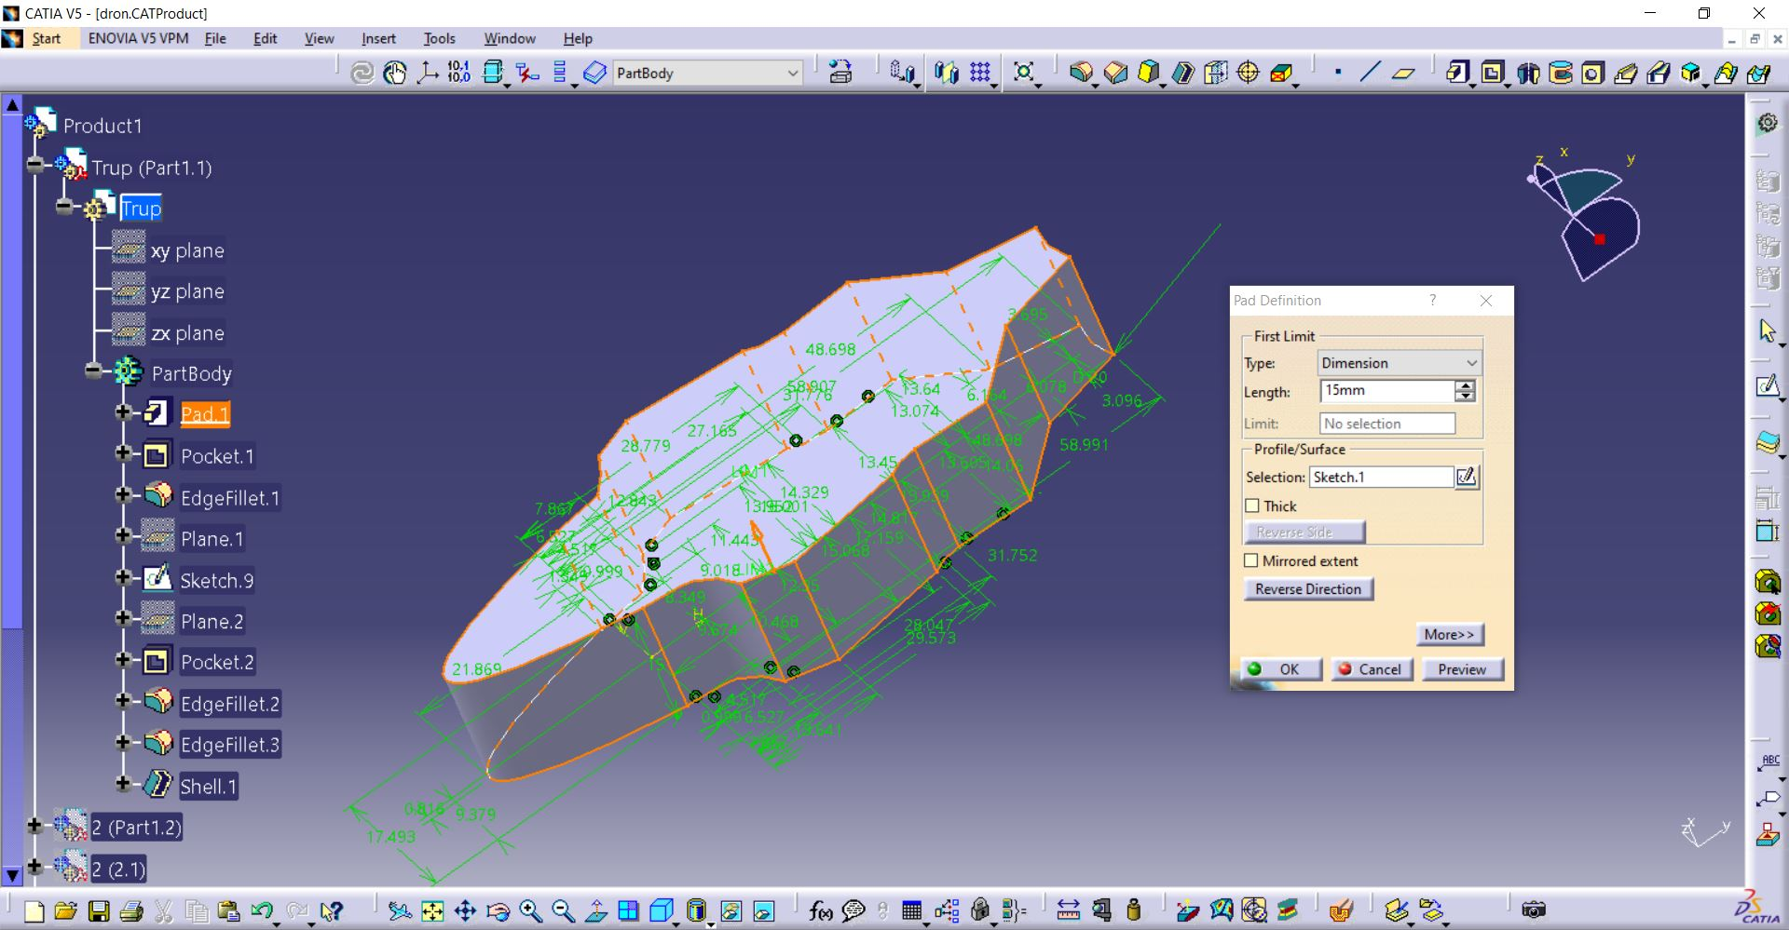

Slide 30
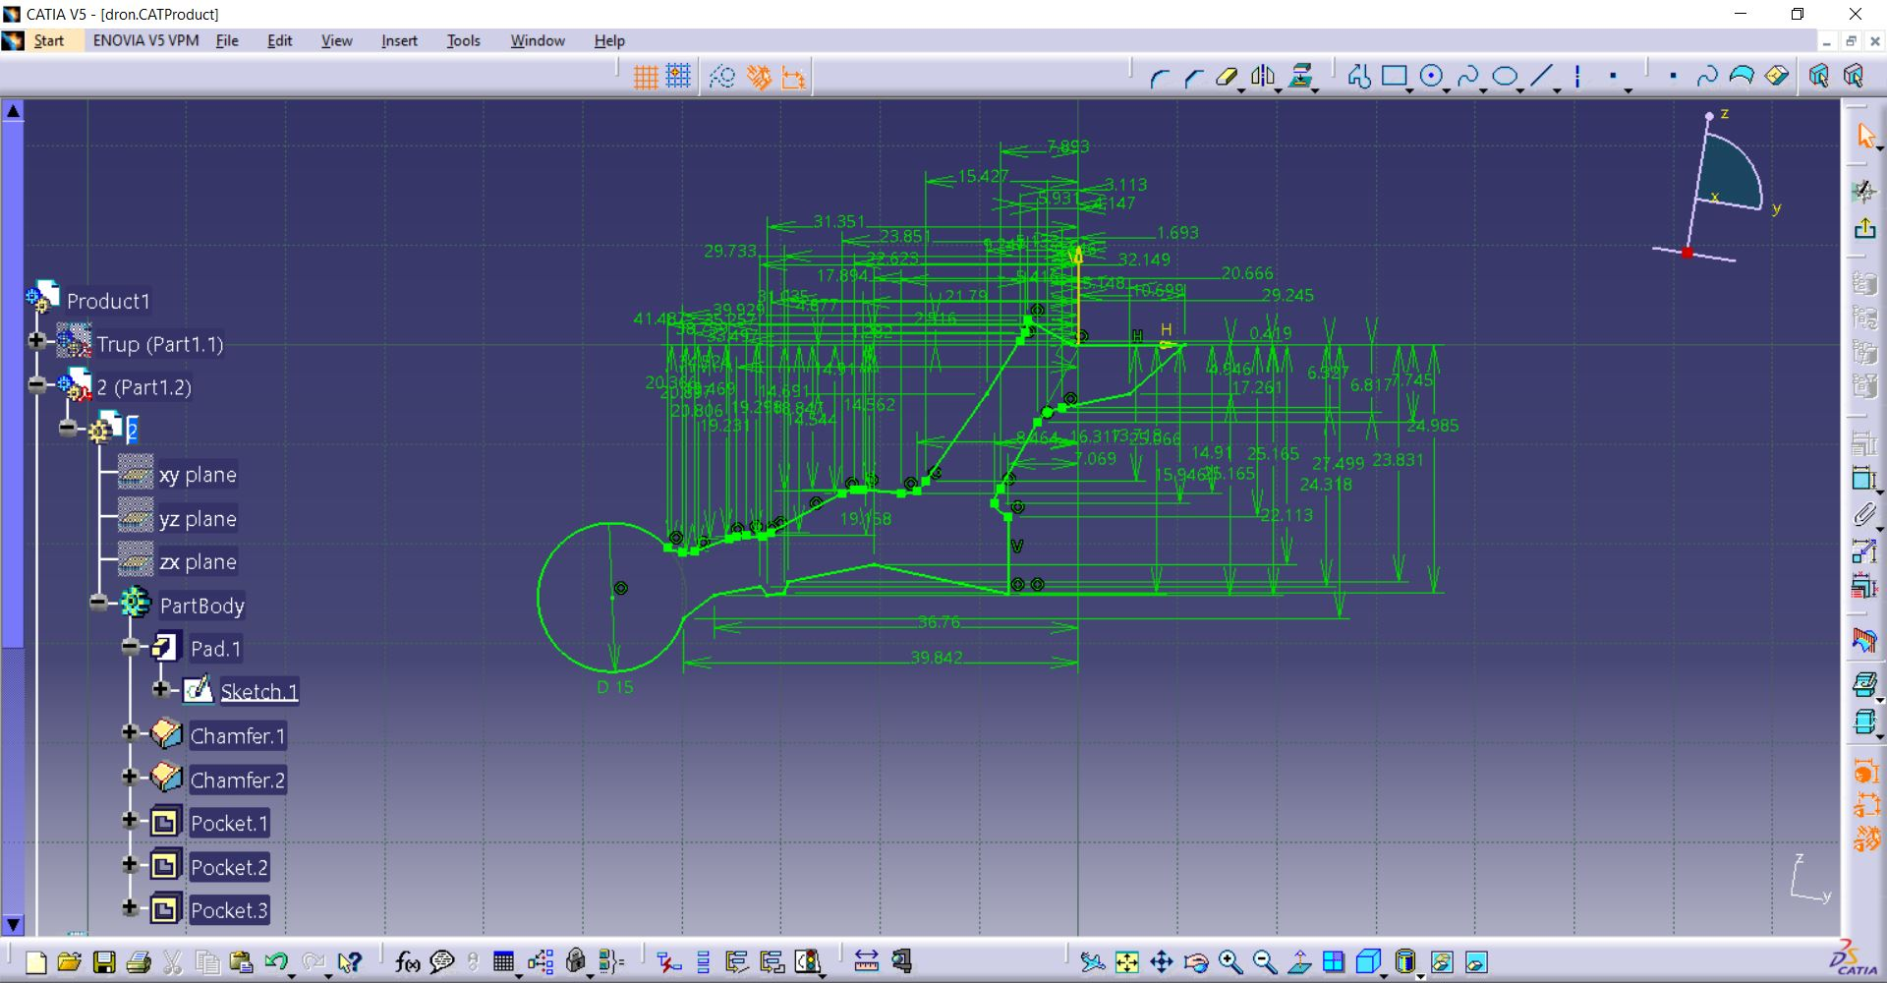

Slide 31
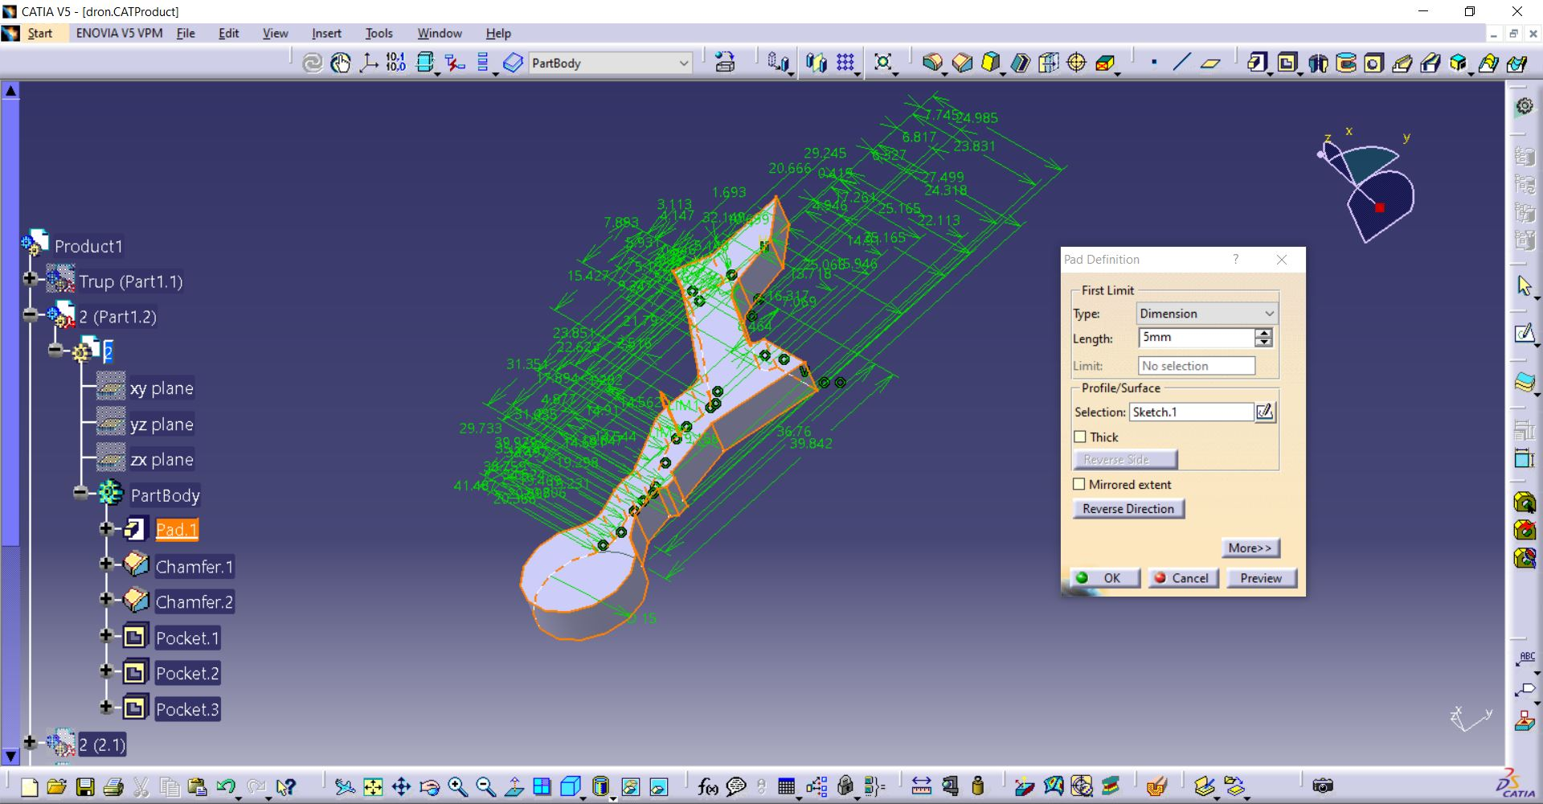

Slide 32
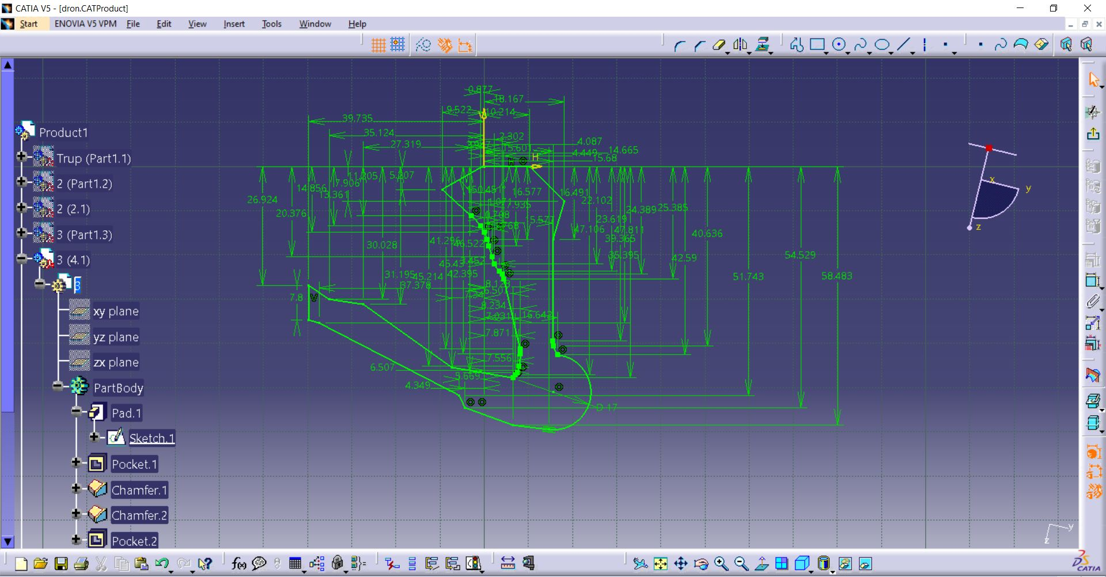

Slide 33
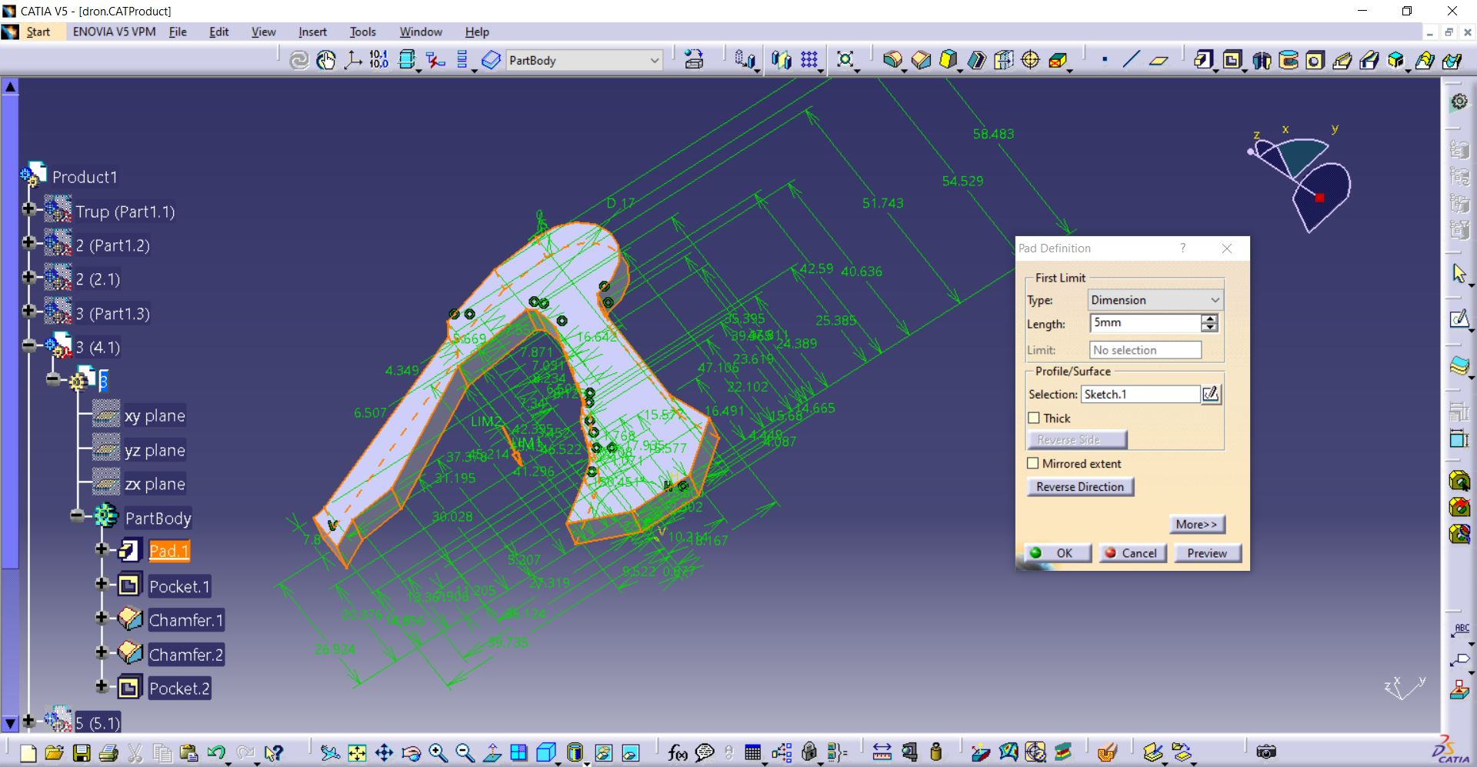

Slide 34
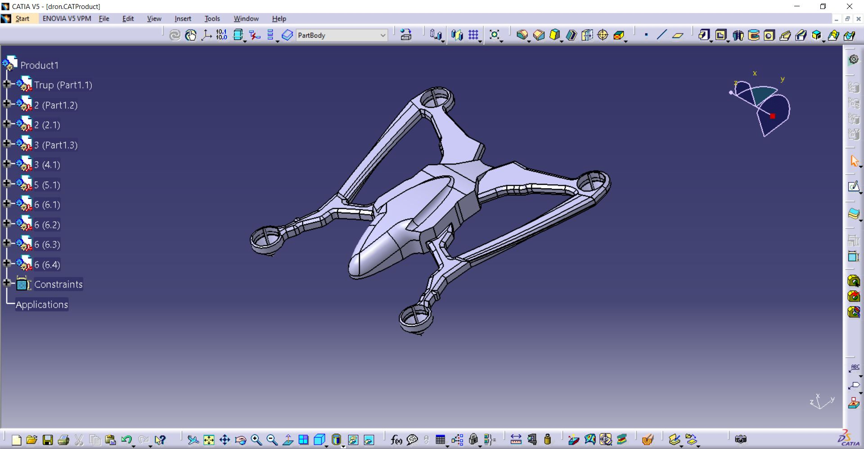

Slide 35
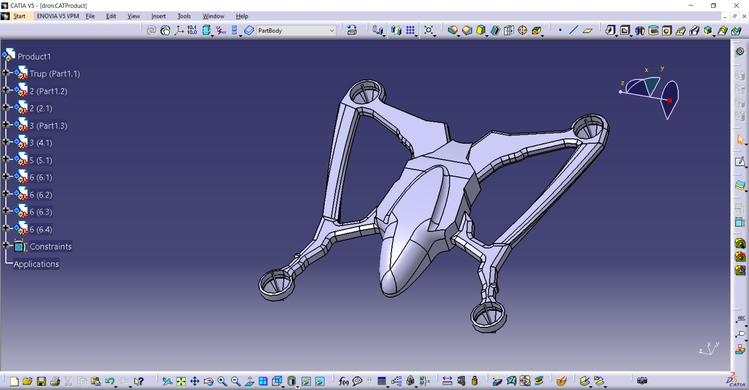

Slide 36
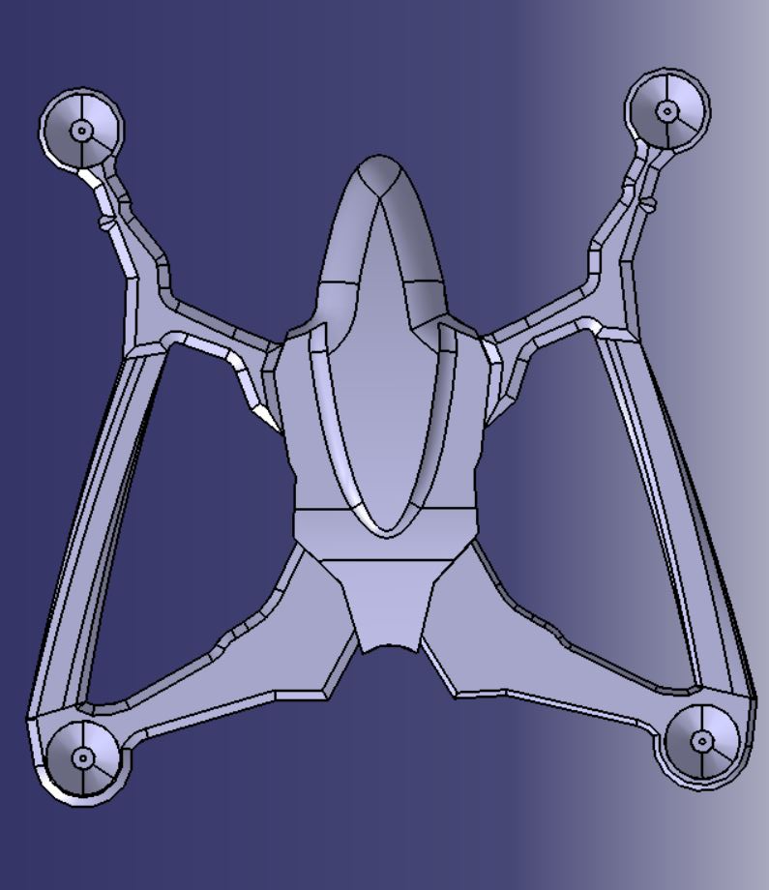

Slide 37
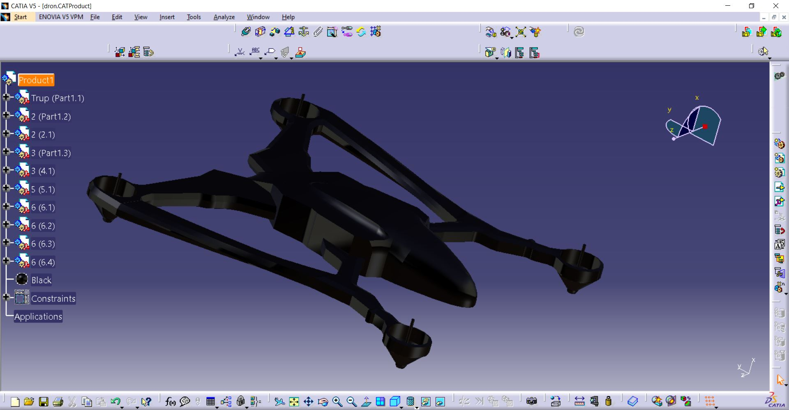

Slide 38
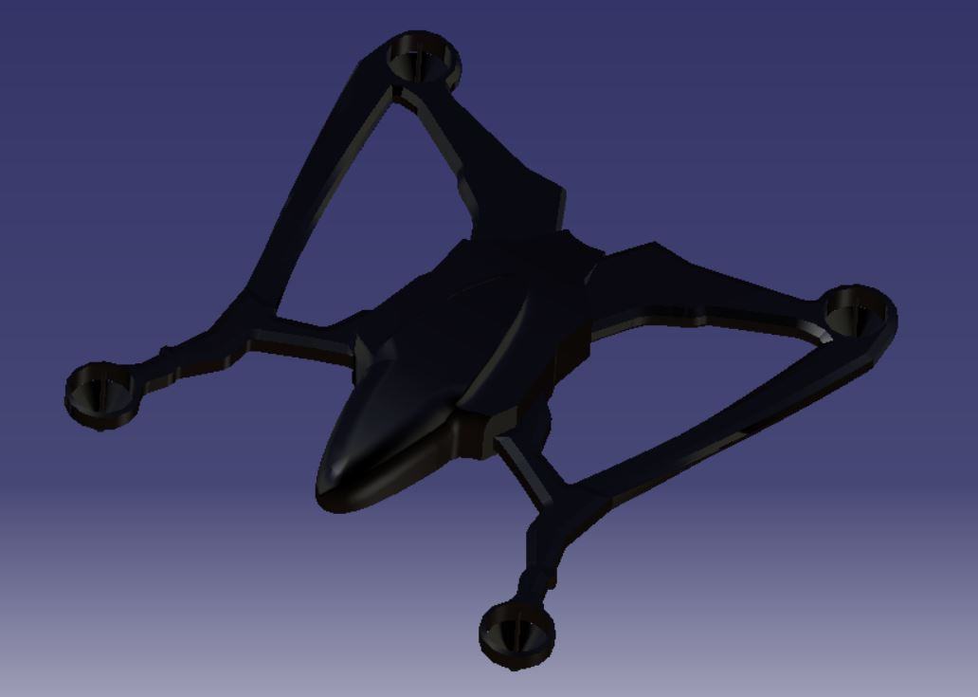

Slide 39
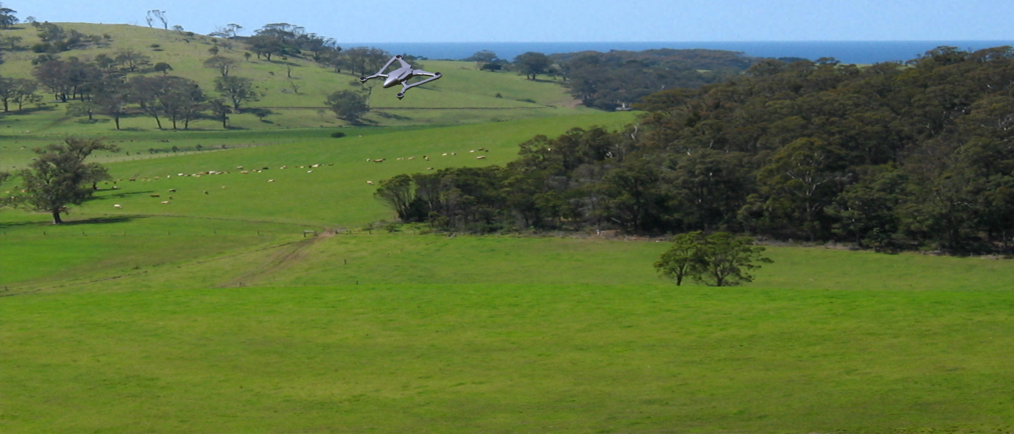

Slide 40
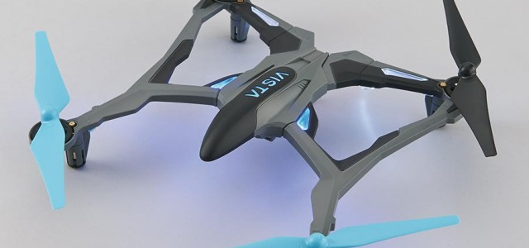

Slide 41


